Slide 1
STAYING HEALTHY DURING COLD AND FLU SEASON

Slide 2
STAYING HEALTHY
FREQUENT HAND WASHING
AVOID CLOSE CONTACT WITH SICK PEOPLE
STAY HOME IF YOU ARE SICK
GET YOUR SEASONAL FLU SHOT
KEEP INFORMED
Notes:
-Cover mouth and nose when you cough or sneeze.
-Don’t touch your face.
-Keep informed and listen to advice from public health experts.

Slide 3
FLU SYMPTOMS
100ºF or higher fever or feeling feverish (not everyone with the flu has a fever)
Cough and/or sore throat
Runny or stuffy nose
Headaches and/or body aches
Chills
Fatigue
Nausea, vomiting, and/or diarrhea (most common in children)

Slide 4
EFFECTIVE HAND WASHING
WET
Wet your hands with warm water
APPLY
Apply soap
RINSE
Rinse the soap from your hands
DRY
Dry your hands completely with a clean towel
SCRUB
Scrub the back of your wrists, palms, of hands and under the fingernails. For at least 20 seconds
Notes:
-Since the flu virus can live on surfaces that we touch each day, our hands become a potential source of infection. Effective hand washing helps remove the flu virus as well as other germs.
-People do not wash their hands enough during the day and are not washing their hands well enough to remove germs.
-It does not matter the type of soap you use.

Slide 5
COMMUNITY STRATEGIES
Keeping people apart helps slow the spread of flu
Isolation and treatment for sick people
Facial coverings when in public places
Social distancing
6 feet
Voluntarily stay home. Decide on your own to stay away from people
Limit time spent in crowded areas
Notes:
-Flu is spread where people spend a lot of time together, so we have to keep them apart.
-Isolation is the separation of sick people from healthy people.
-To decrease contact between healthy and infected people.
-It helps to stay at least 6 feet away from others to help reduce your chances of catching the flu.

Slide 6
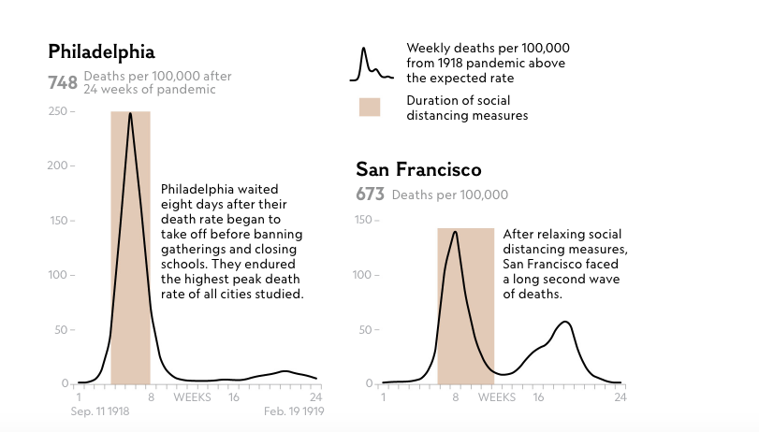
IMPACT OF SOCIAL DISTANCING
Social distancing is a very necessary tool when combating a novel virus or a virus that is highly infectious and deadly.
Variables such as duration of social distancing measures play a big role in minimizing the number of weekly deaths reported.
Notes:
-This graph shows the experiences of two US cities during the fall of 1918 during the world’s last devastating flu pandemic.
-Philadelphia had a large number of flu deaths over a short period of time.
-St. Louis had far fewer deaths spread out over a long period of time.
-Why did this happen? In Philadelphia, they held a parade on 9/28 and crowds packed the parade route. (Philadelphia’s Liberty Loan Parade)
-In St. Louis, the mayor closed “theaters, moving picture shows, schools, pool and billiard halls, Sunday schools, cabarets, lodges, societies, public funerals, open air meetings, dance halls and conventions until further notice.” This was done very early in the pandemic.
-The slight up-tick of deaths in St. Louis in December was due to the lifting of control measures before it was safe to do so.

Slide 7
WHAT IF YOU GET SICK?
CALL YOUR HEALTH-CARE PROVIDER
AVOID OTHERS FOR AT LEAST 24 HOURS AFTER FEVER RESOLVES
TREAT SYMPTOMS
COVER COUGHS AND SNEEZES
FREQUENT HAND WASHING
DRINK PLENTY OF FLUIDS
REST
Notes:
-If you need medical attention, call your healthcare provider.
-Do not go to the ER unless it truly is an emergency.
-If you go there unnecessarily, you may delay care for others who have real emergencies.
-Also, if you don’t have the flu, you could contract it while you’re there from someone who does and bring it home with you.

Slide 8
CONTACT US:
THE OCEAN COUNTY HEALTH DEPARTMENT
175 SUNSET AVENUE
TOMS RIVER, NJ 08754
(732) 341-9700
Notes:
-Best sources of information are government public health agencies such as the CDC, the NJ Department of Health and Senior Services or the Ocean County Health Department.

