Slide 1
Taking the stress out of the 2020 school year
Tips for a healthy and stress-free school year from the ocean county health department’s Health Education division

Slide 2
Unprecedented times
This school year is like no other. We are amidst a national pandemic of a novel virus, schools have specific guidelines to adhere to for a safe re-opening, there is constant information circulating on the internet and news channels, and as a parent you are flooded with worry, stress, and fear for your child’s wellbeing.
There are many decisions to make, and as parents you want to be sure you are making the best decision for your child. This presentation will navigate the many options for schooling to help you choose which is best for your family, introduce ways to keep your children entertained while social distancing, introduce coping strategies for times of high stress and anxiety, and provide tips on how to keep your family healthy during this school year.

Slide 3
Re-opening plans for schools which option is best?
In person- All schooling will be done in the classroom, with necessary precautions in place to protect students and teachers from potential virus exposure
this option would be best for parents who work full time and are unable to commit to homeschooling their children
Online- Schooling will be done 100% virtual from home
this would be most suitable for parents who have flexibility in their work schedule who are able to work remotely, or stay at home parents who are able to be home through the work week
Hybrid- A combination of in person and online education. Students will attend school in person on some days and the remaining days will be virtual from home
this option is best for parents who have both flexibility in their work or personal schedules. This model is the “best of both worlds” for parents who want their child to socialize, while also reducing contact with others

Slide 4
Keeping children socialized while social distancing
Social Distancing, also known as “physical distancing” is the act of limiting close face-to-face contact with others to reduce the spread of COVID-19
CLICK HERE to learn more about social distancing
It is very important to adhere to the social distancing guidelines set forth by health officials. As a parent, you may be struggling with ways to balance socialization for your child by allowing them to do things they enjoy, while following social distancing recommendations. There are many reasons why it is important to find ways to adapt to this temporary way of living, some include:
Your child may be having a hard time getting their energy out while restricted to at home play
You may be struggling find activities to entertain and stimulate your child
Your family may be feeling a sense of isolation and depression from less face to face contact with family and friends

Slide 5
Socializing while social distancing
The next few slides include ideas of ways to socialize while practicing social distancing. These are just some of the many ways you and your family can get out and about in a safe way

Slide 6
Socializing while social distancing: get outside
There are many outdoor activities that can be done while remaining a 6 feet distance from others. Outdoor activities are a great way to get fresh air and change the scenery from being inside the house all day. Here are just a few great outdoor activities:
Bike riding
Walking/Running
Hiking
Fishing
Swimming
Go to the park
Beach day
Outdoor dining
Socially distanced visit with family or friends
Playing non-contact sports

Slide 7
Socializing while social distancing: Virtually connect
There are many ways to connect with family and friends that don’t involve face to face contact. Here are some great ways to virtually connect
FaceTime/video calls
Interactive video game chats
Organize a web-based game night
Join an online book club

Slide 8
Socializing while social distancing: staying in
Socializing does not always mean being in large crowds of people or attending parties. There are many ways to enjoy time in together as a family. You can use this time to bond and create happy memories with your children at home. Here are some ways to connect, together:
Family game night
Cleaning the house
Cooking challenge
Movie night

Slide 9
Coping with stress and anxiety
The pressure to take on multiple roles at once has led to much stress and anxiety among our families. As parents, you are wearing more hats than ever.
During the past few months you have adapted to the nuances of your career whether that be working from a virtual capacity or navigating unemployment, you became a full time teacher while simultaneously managing the home, and you have been distanced from family and friends with your children looking to you as their source of constant entertainment.
There are a lot of “firsts” which may be extremely overwhelming. The good news is, there are many things you can do to manage the emotions you may be feeling. The next few slides will provide ways to cope and manage stress and anxiety.

Slide 10
Coping with stress and anxiety: schedule you time into your day
It may sound overwhelming to schedule ANYTHING else into your jam-packed day, but taking time to do something for yourself that you enjoy will give you a mental break. Here are some ideas of things you can do alone:
Take a bath
Go to the grocery store
Call a friend
Read a book or journal
Sit by the bay or ocean and watch the water
It has been proven that the sounds and scenes of the water trigger a happy response in your brain

Slide 11
Coping with stress and anxiety: get moving
Exercise releases hormones in the human brain called ”endorphins”. After finishing a workout, these “happy hormones” release and help your mood to improve. Some great exercises you can do from home include:
Taking a run around your neighborhood
Bike ride
Walking
At-home video workouts
Live streamed group fitness classes
Weightlifting

Slide 12
Coping with stress and anxiety: stay connected with family and friends
Calling a friend or family member may seem old school, but communicating with others provides an emotional outlet and discuss what we may be feeling. If talking on the phone isn’t your thing, try some of these communication methods:
Text a friend
FaceTime
Connect with friends through social media
Zoom chat with some of your close family members or friends

Slide 13
Keeping your family healthy
It is especially important to keep your family healthy during this time, especially if your child will be attending school or daycare. The next few slides will introduce some easy ways to create a family wellness routine

Slide 14
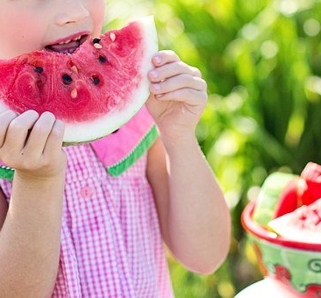
Keeping your family healthy: eating healthy
A nutrient rich diet helps the immune system to function optimally. A body that is fueled by healthy whole-foods is less likely to get sick. Here are a few quick tips when planning your next grocery haul:
Shop the perimeter of the store – fruits, vegetables, and perishable items are less likely to be filled with preservatives or additives. Aim to shop along the perimeter of the grocery store for the majority of your foods
Eat the rainbow – the more colorful the fruits and vegetables, the more antioxidants and vitamins they have in them.
Order out less– cooking your own food helps you to know what is in it and allows you to create wholesome foods that aren’t fat and grease laden
Snack on fruits and vegetables – Packaged snacks typically have a lot of added sugars and preservatives, fruits and vegetables are a great alternative
Drink more water– Stay hydrated by drinking water, and ditch juices and sports drinks that are usually loaded with added sugars

Slide 15
Keeping your family healthy: don’t skip well doctor visits
Routine doctor visits are more important than ever to make sure your child is up to date on their immunizations and physicals. Your pediatrician's office is following all the necessary precautions, with some added safeguards in place, to ensure that your child will be able to attend well-visits without the risk of being exposed to any health threats

Slide 16
Keeping your family healthy: make physical fitness a priority
If you are homeschooling your child, that means they are behind their computer screen or desk for many hours of the day. Incorporating physical activity into the day will help them to focus on their schoolwork by getting their jitters out, and will keep their bodies healthy. Try some of these fun break-time activities to keep your family moving:
Play soccer or catch
Set up an obstacle course
Relay races
Push up or jumping jack challenge
Swimming in the pool

Slide 17
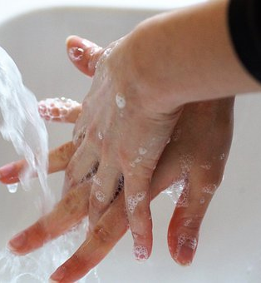
Keeping your family healthy: practice good hygiene
Personal hygiene may be our best defense against viruses and bacteria. Children frequently touch their face or put their hands and other objects in their mouth without a thought of germs. Here are some things that you can encourage your child to do to help them stay germ-free and avoid spreading their germs to others:
Frequent hand washing – Hand washing with soap and water for at least 20 seconds
Shower daily
Sanitizing frequently touched objects – your child may give you their school supplies, favorite toys, or digital devices for you to clean daily
Covering a cough or sneeze – Teaching your child to cover their cough or sneeze into their elbows is very important

Slide 18
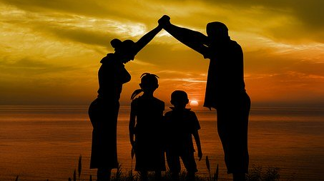
“You are doing the best you can, and that is everything your child needs right now”

Slide 19
CONTACT US:
THE OCEAN COUNTY HEALTH DEPARTMENT
175 SUNSET AVENUE
TOMS RIVER, NJ 08754
(732) 341-9700

